Slide 1


The tragedy of flight- a comprehensive crash analysis
TEAM MEMBERS
H.GOHUL
K.RAHUL DEVA
R.ESWARAPADI
S.Rakesh

Slide 2
Introduction
our project involves collecting and analysing data from a variety of sources related to airplane crashes, including accident reports, flight data, maintenance records, and weather reports. The data is then cleaned, processed, and analysed using various statistical techniques to identify patterns and trends.

Slide 3
MILESTONE 1
PROBLEM UNDERSTANDING
For milestone 1, we create an empathy map and brainstorming. By this we can easily understand the problem in the flight

Slide 4
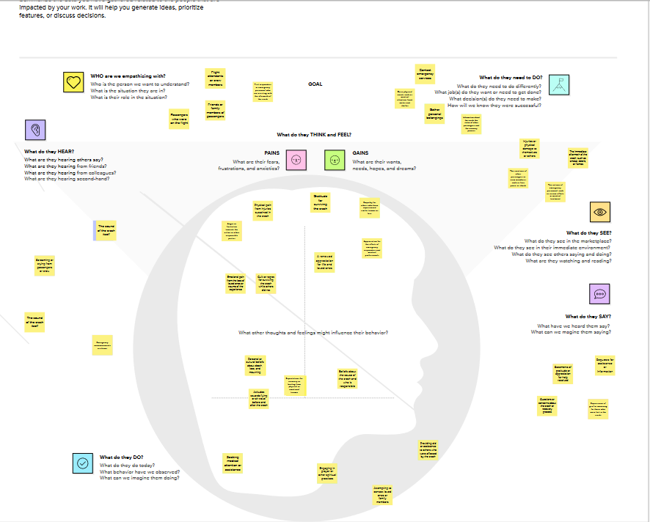
EMPATHY MAP

Slide 5
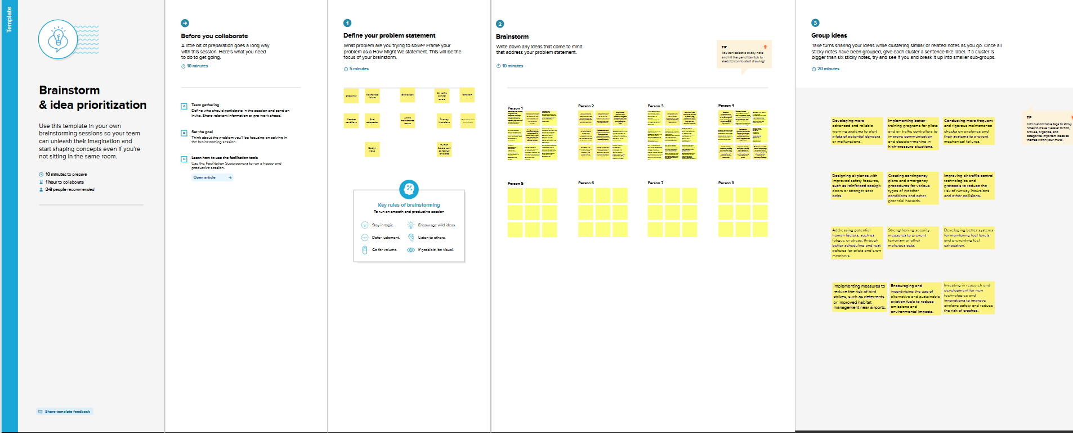
BRAINSTROM-ING

Slide 6
MILESTONE 2
Data collection and data extraction
we had collect the data for our project from the link, next storing the data in a database by SQL workbench and finally we connected the database with our tableau account

Slide 7
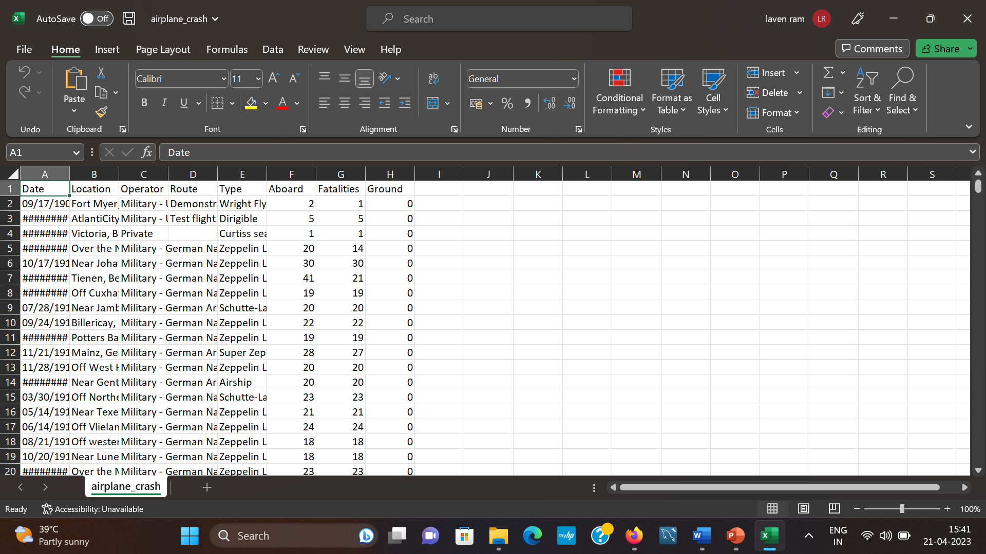
Milestone 3
DATA PREPARATION
In this milestone, we prepare our data suitable for creating the data visualization in tableau public.

Slide 8
Milestone 4
Data visualization
In this milestone, we created graph from our extracted data for the data visualization

Slide 9
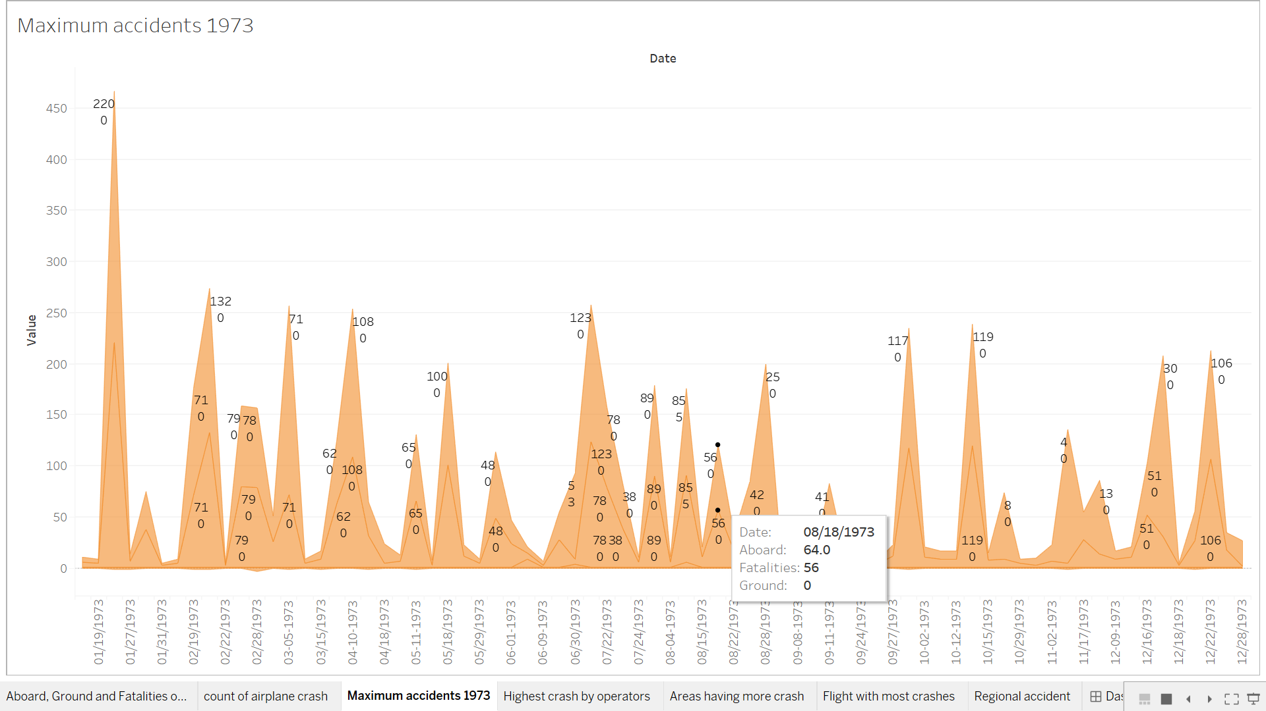
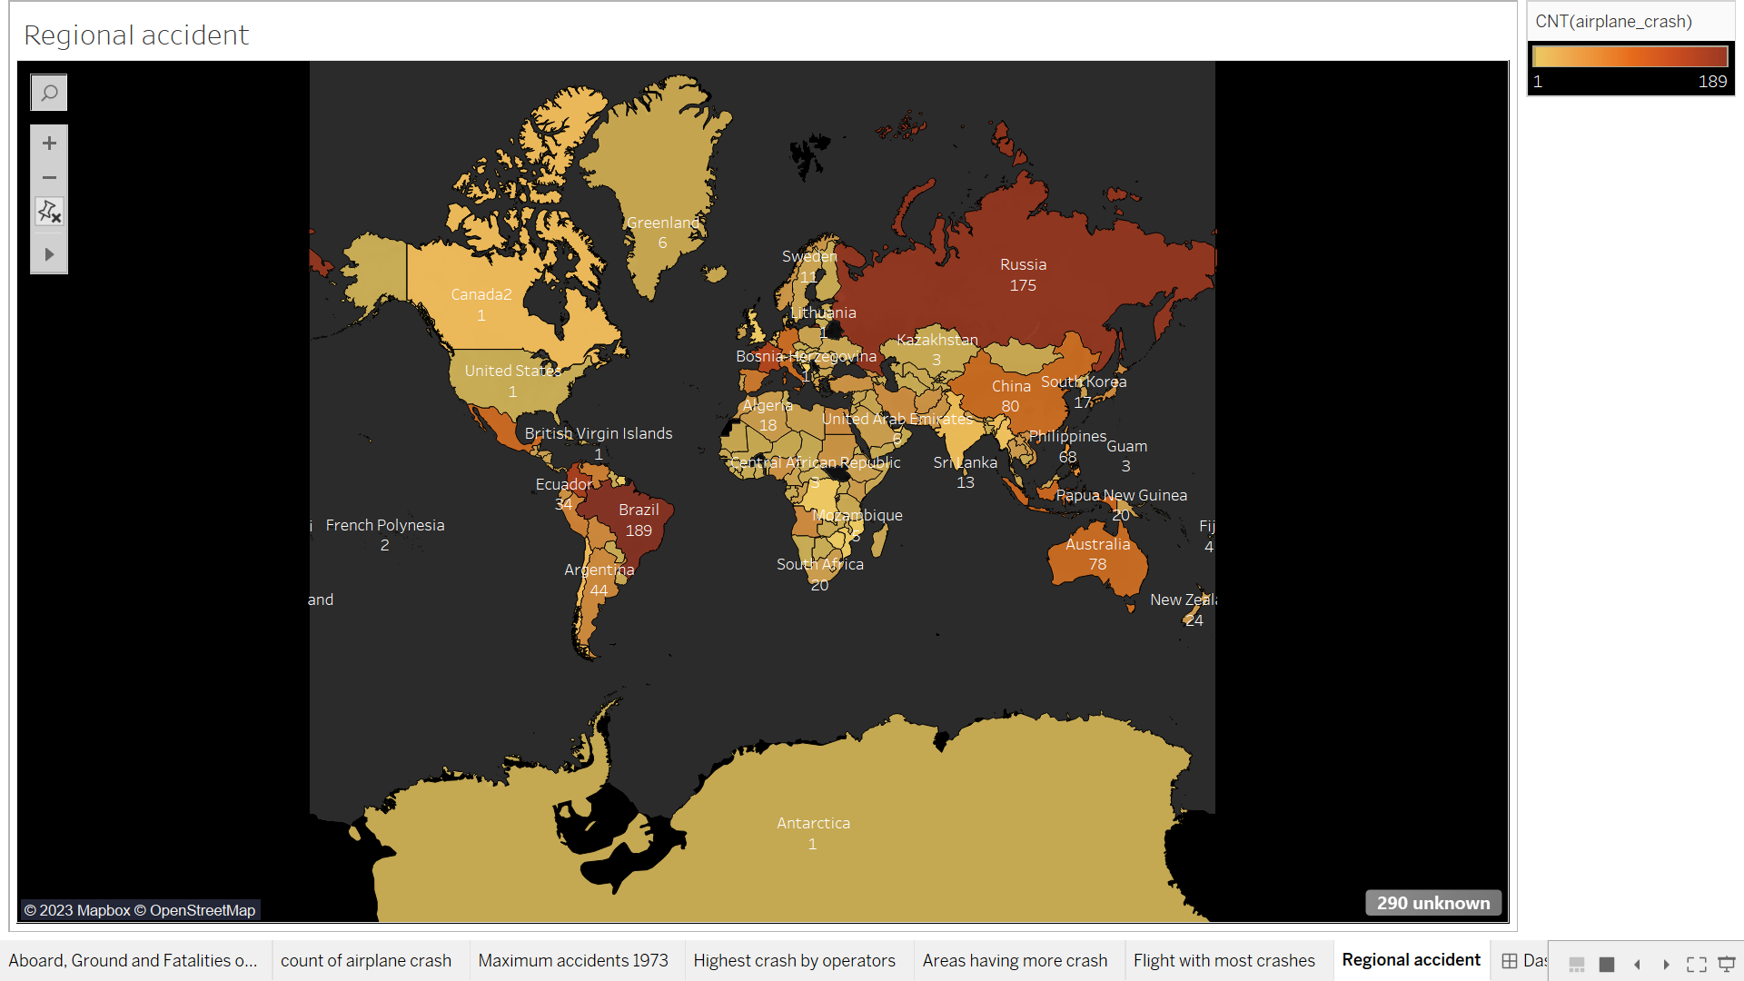
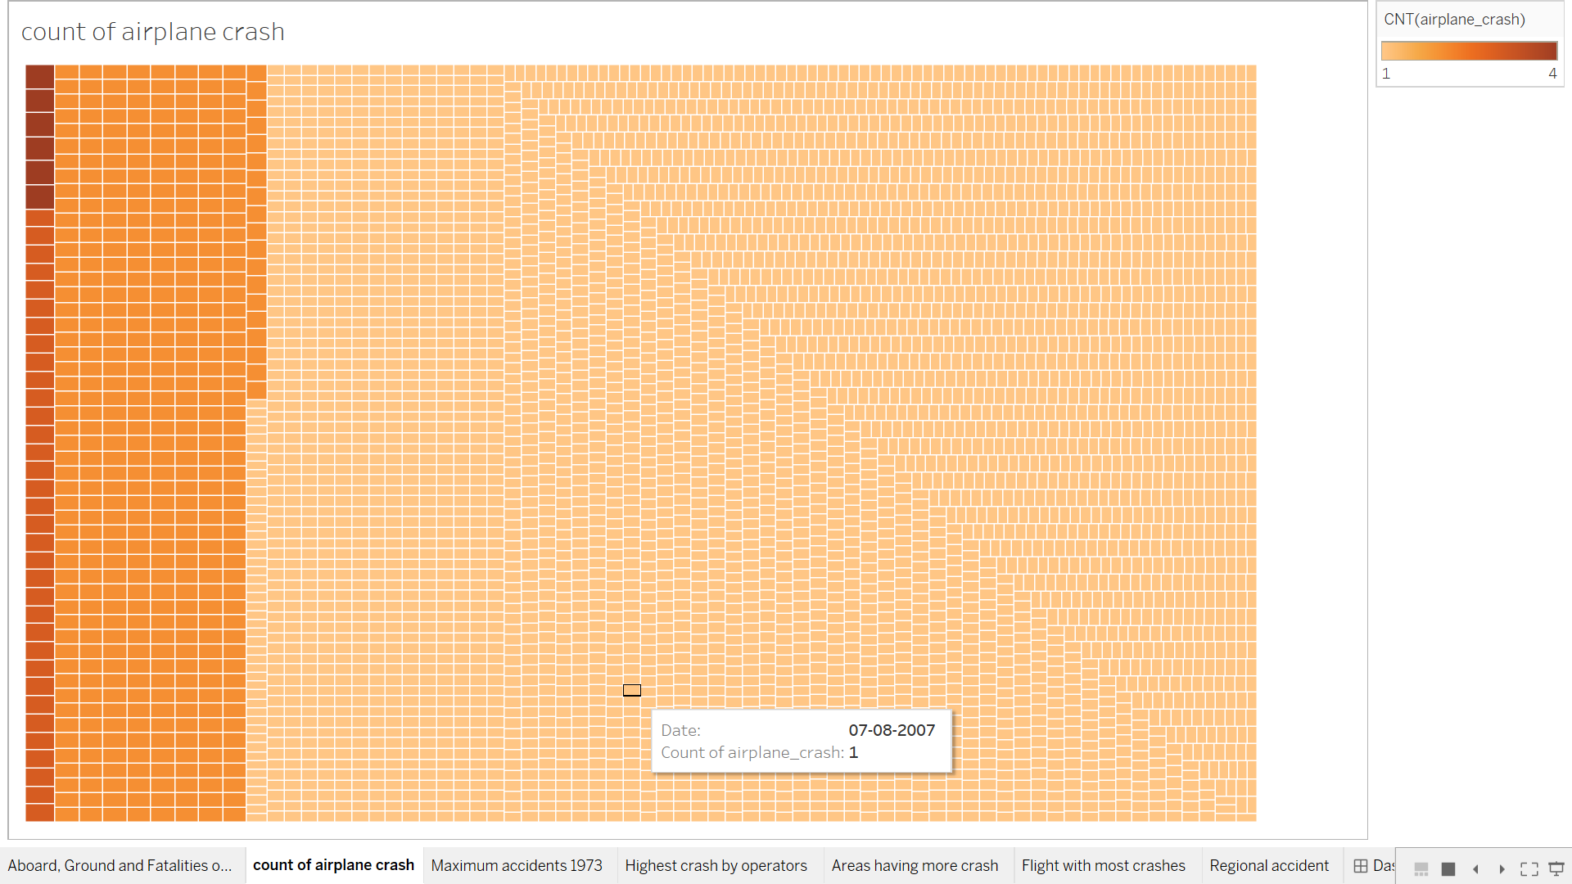
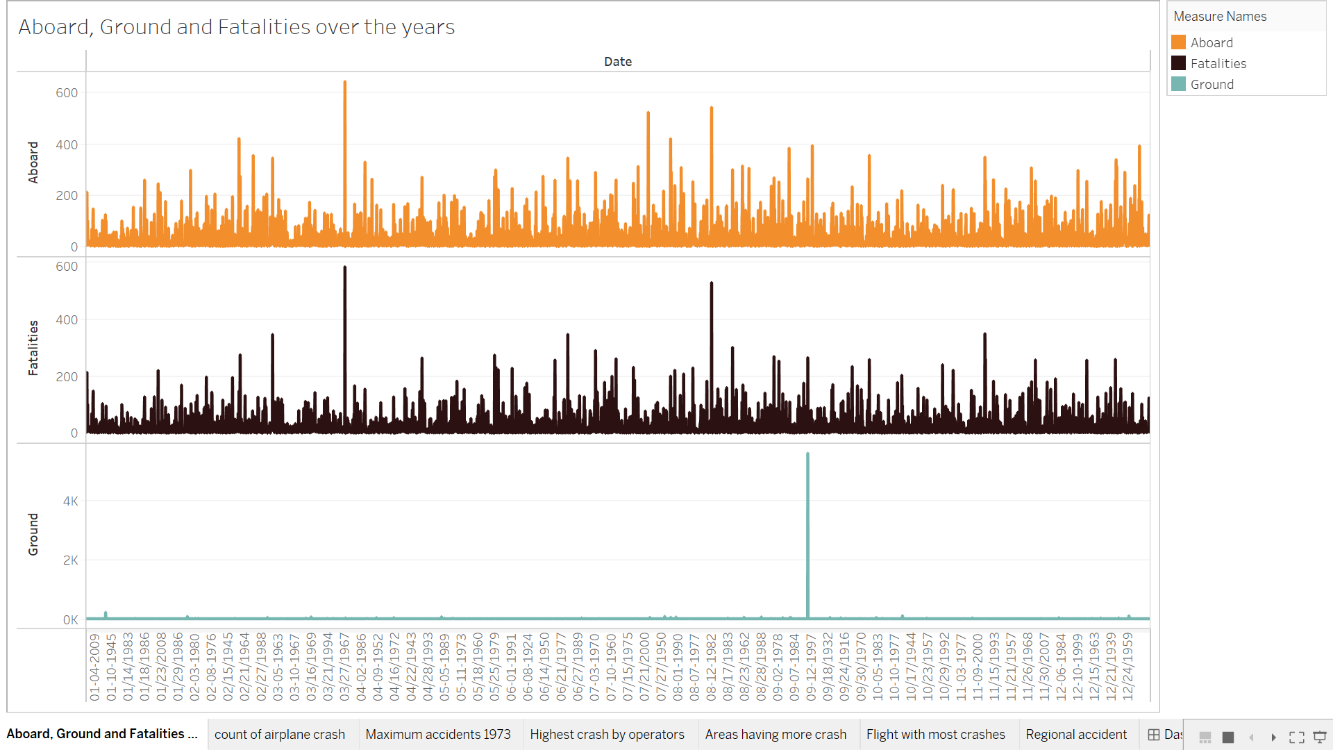
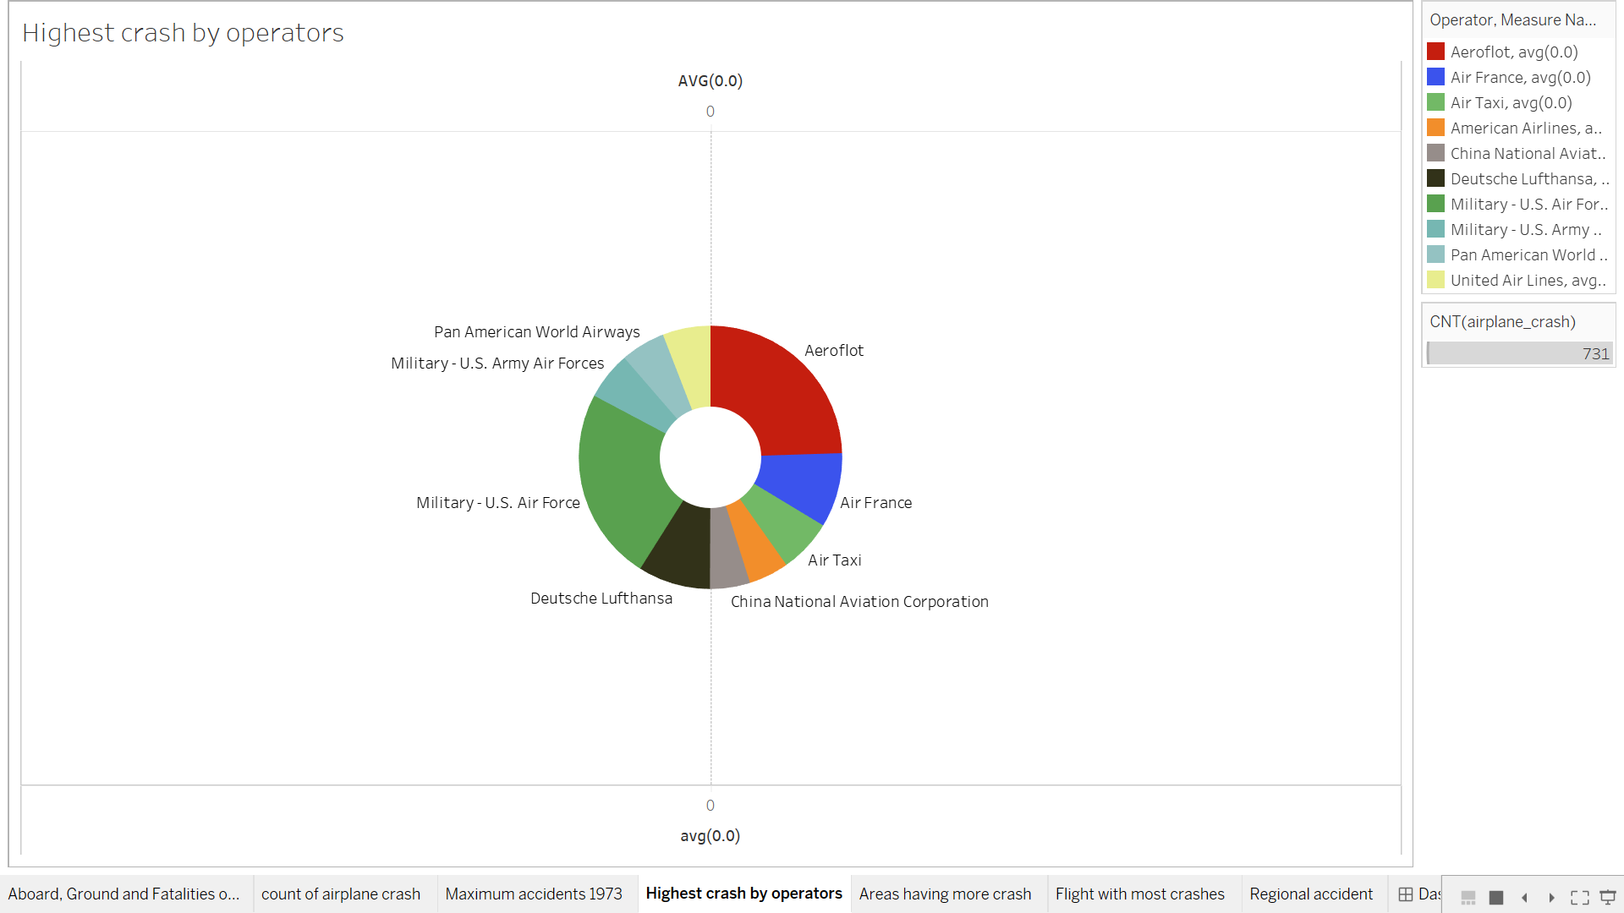
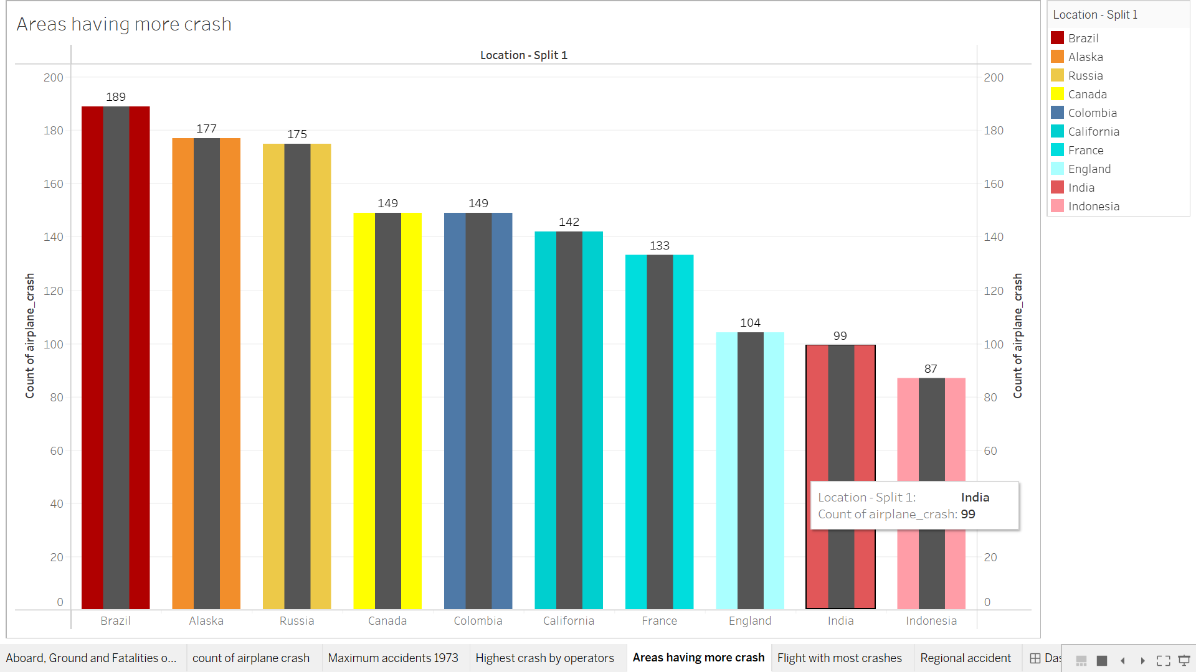
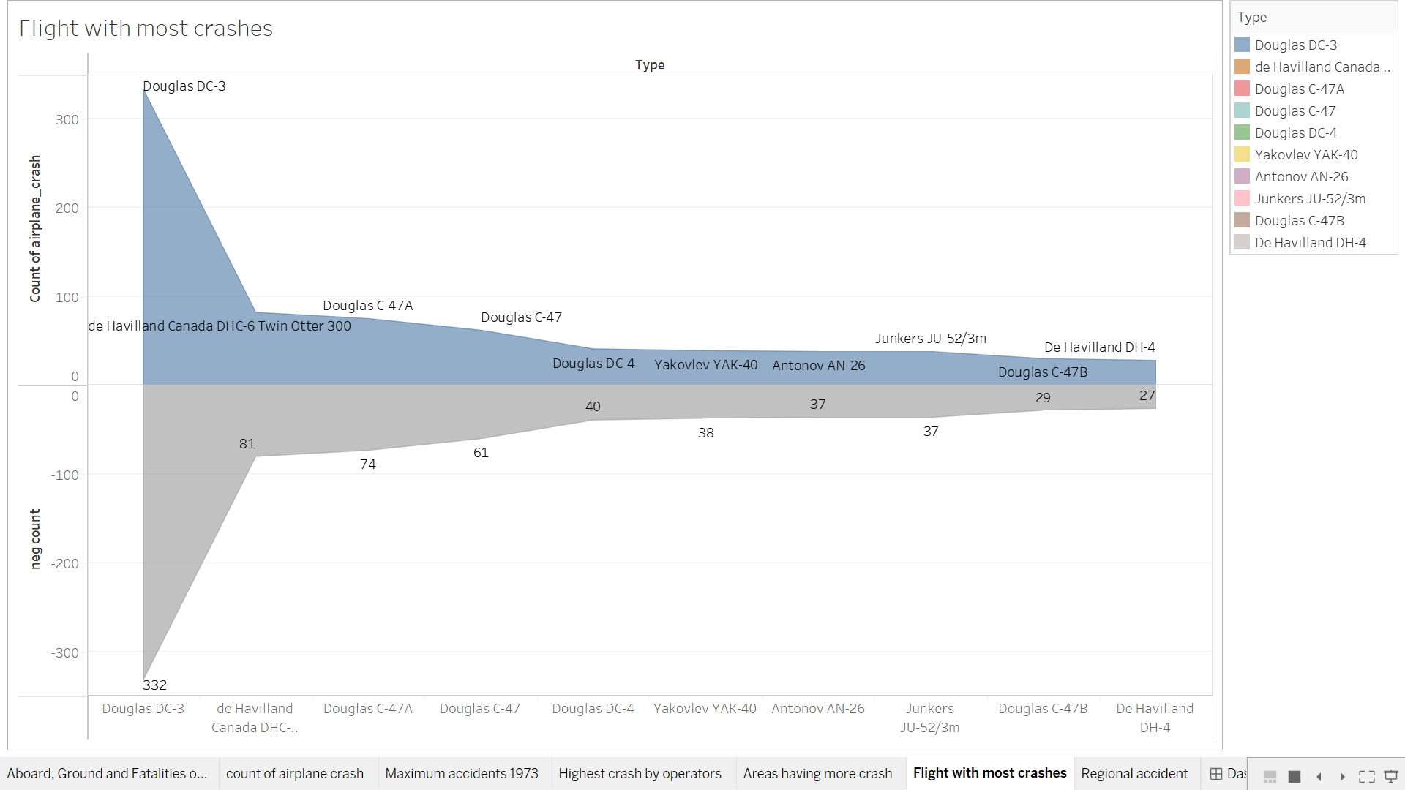
DATA VISUALIZATIONS

Slide 10
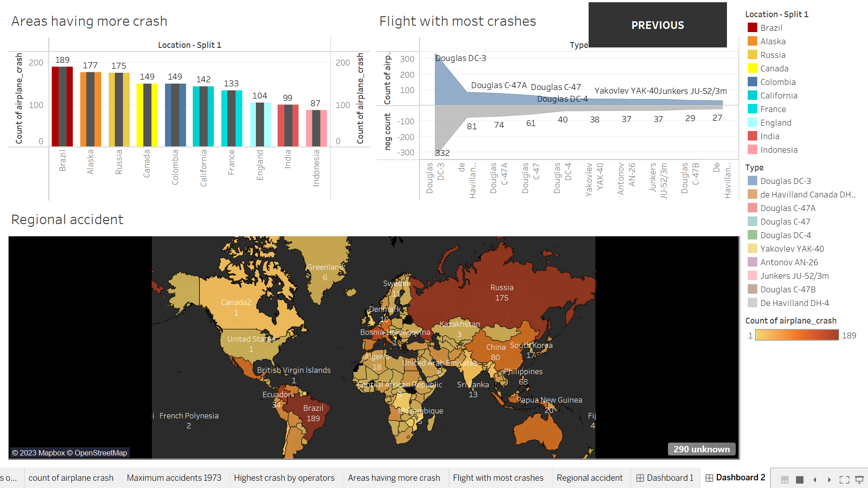
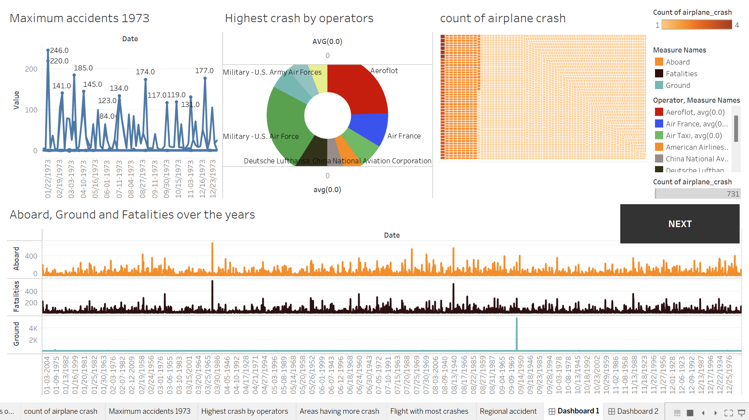
MILESTONE 5
DASHBOARD
In this milestone, we create a dashboard for our data visualization

Slide 11
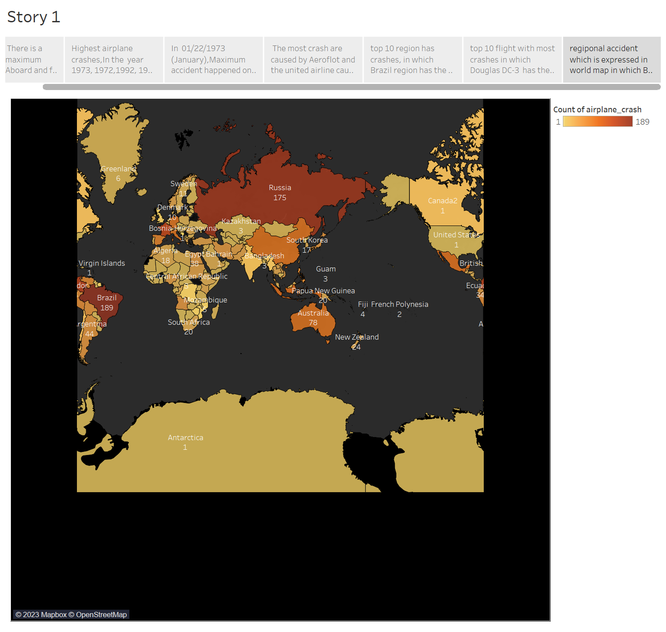
MILESTONE 6
STORY
In this milestone, we create a story for our data visualization
y

Slide 12
MILESTONE 7
PERFORMANCE TESTING
In this milestone, we test our data visualization.

Slide 13
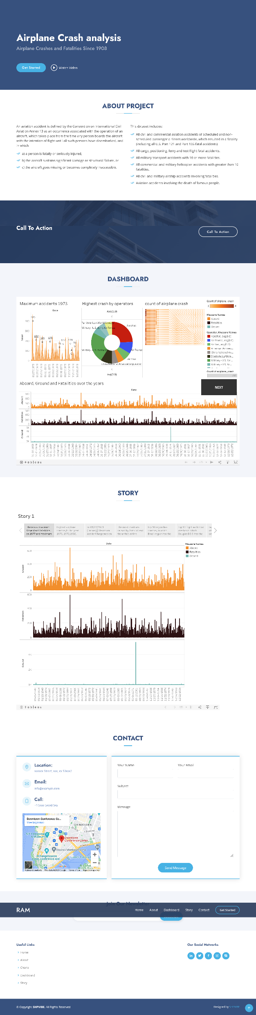
MILESTONE 8
WEB INTEGRATION
In this milestone, we create a website for our visualization

Slide 14
CONCLUSION
The conclusion of this project is to give some awareness and recommendation for improving safety and preventing similar accidents in the future

